Slide 1


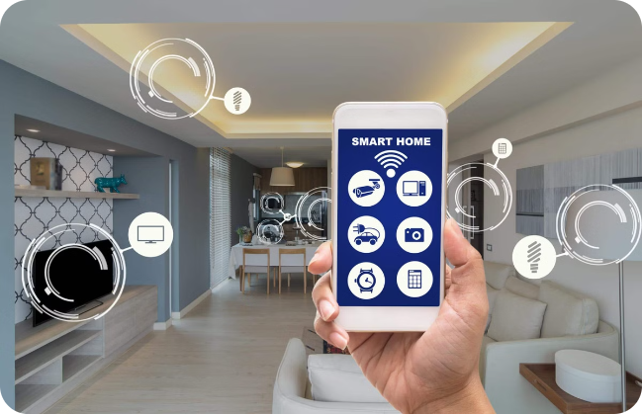

Introduction to the Internet of Things (IoT)
The Internet of Things (IoT) is a network of physical devices, vehicles, home appliances, and other items embedded with electronics, software, sensors, actuators, and network connectivity that enable these objects to collect and exchange data.
by Swaraj kumar

Slide 2
Embedded Systems vs. IoT
Embedded Systems
IoT Devices
Embedded systems are designed for specific tasks, have limited resources, and operate independently. They are often used in devices like washing machines, cars, and traffic lights.
IoT devices are connected to the internet, allowing them to communicate and share data with other devices and systems. This enables remote control, automation, and data analysis.

Slide 3
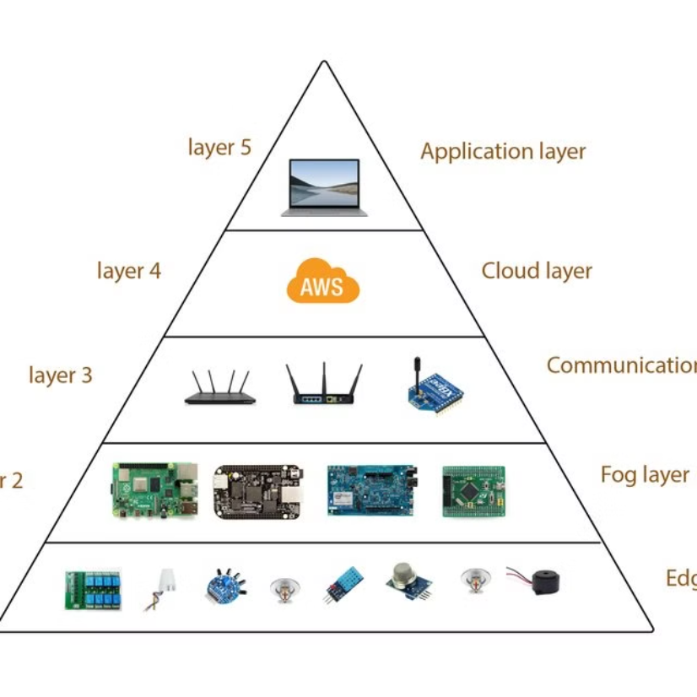
Layers in IoT

Slide 4
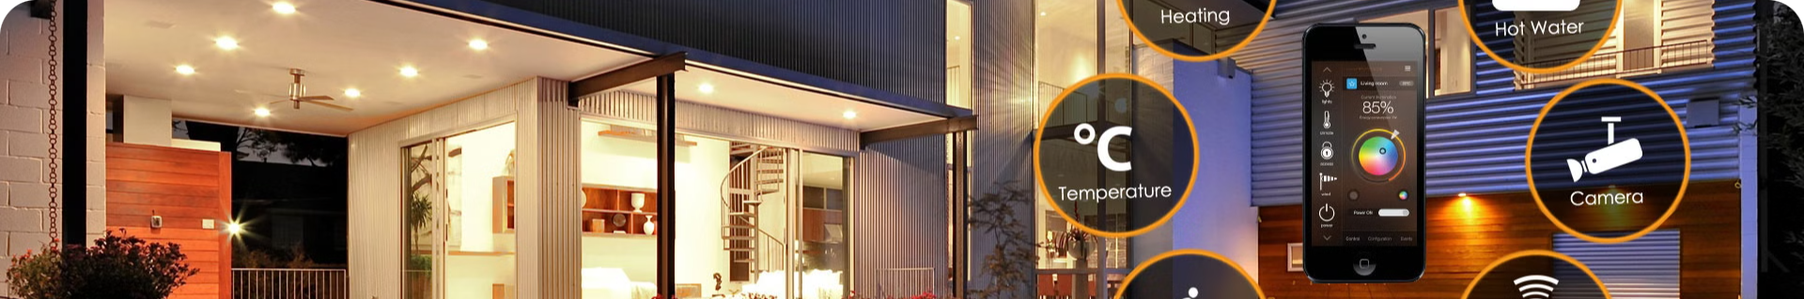
Layers of the Internet of Things
1
Perception Layer
This layer consists of sensors, actuators, and other devices that collect data from the physical world.
2
Network Layer
This layer connects devices to the internet and facilitates communication between them.
3
Application Layer
This layer provides services and applications that use the data collected by IoT devices.

Slide 5

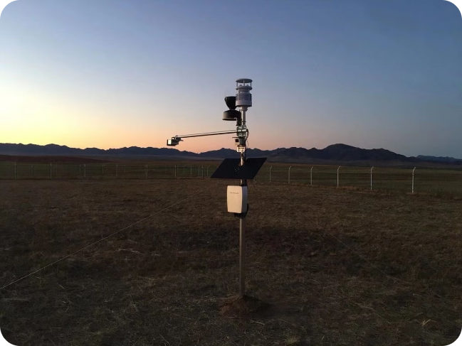
The Perception Layer
Sensors
Actuators
Sensors are devices that measure physical quantities such as temperature, humidity, light, and motion. They convert these measurements into digital signals that can be transmitted over a network.
Actuators are devices that control physical processes, such as opening and closing valves, turning motors on and off, and adjusting lighting levels.
Data Acquisition
The perception layer is responsible for acquiring data from the physical world through sensors and actuators.

Slide 6
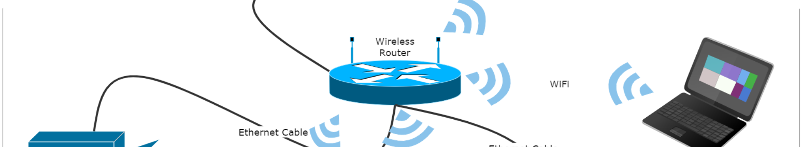
The Network Layer
1
Connectivity
2
Data Routing
3
Security
The network layer provides connectivity between devices and the internet. This includes technologies such as Wi-Fi, Bluetooth, cellular networks, and satellite communication.
This layer manages the flow of data between devices, ensuring that it reaches its intended destination.
The network layer includes security measures to protect data from unauthorized access and ensure reliable communication.

Slide 7


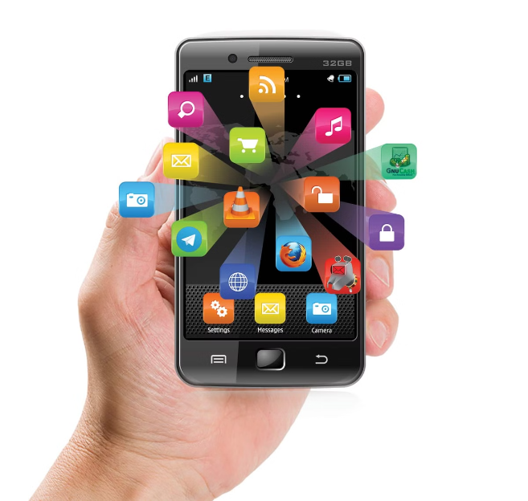


The Application Layer
Cloud Services
Cloud services provide storage, processing, and analysis capabilities for IoT data.
Data Analytics
Data analytics tools allow users to extract insights and patterns from IoT data.
User Interfaces
User interfaces enable users to interact with IoT devices and applications.

Slide 8


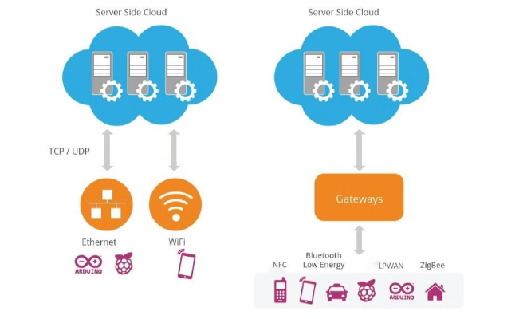



How IoT Works
Data Collection
Sensors collect data from the physical environment.
Data Transmission
Data is transmitted to a central processing unit or cloud server.
Data Processing
Data is analyzed and processed to generate insights and actions.
Feedback and Control
Actions are taken based on the processed data, affecting the physical world through actuators.

Slide 9

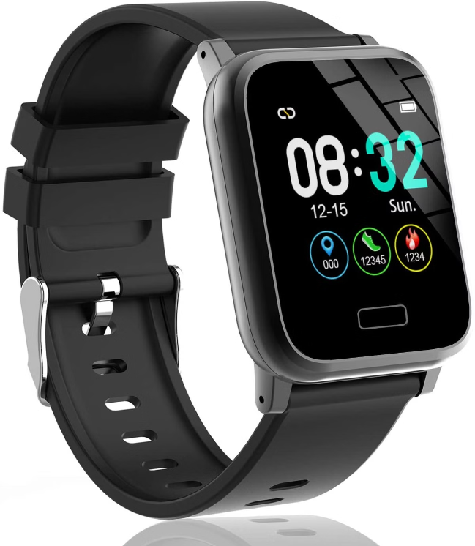
Sensors and Data Collection
Type
Description
Temperature Sensors
Measure temperature in various environments.
Humidity Sensors
Measure moisture levels in the air.
Motion Sensors
Detect movement and changes in position.
Light Sensors
Measure light intensity and color.

Slide 10
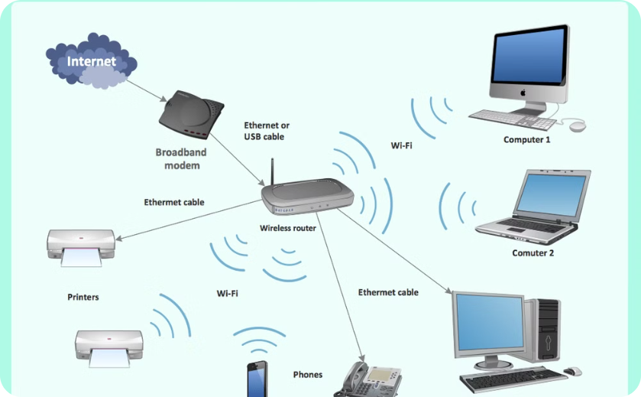
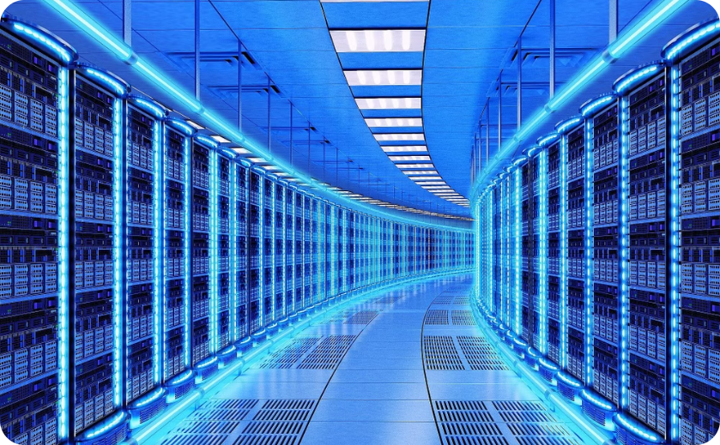
Data Transmission and Processing
Wireless Networks
Cloud Processing
Wi-Fi, Bluetooth, and cellular networks enable communication between IoT devices.
Cloud services provide scalable data storage, processing, and analysis.

Slide 11


IoT Applications and Use Cases
Smart Homes
Smart Cities
Smart homes use IoT devices for automation, security, energy efficiency, and entertainment.
Smart cities use IoT to optimize traffic flow, manage infrastructure, and improve public services.
Healthcare
Agriculture
IoT devices are used in healthcare for remote monitoring, patient care, and medical diagnostics.
IoT applications in agriculture help farmers monitor crops, optimize irrigation, and improve yields.

